Slide 1
Chapter 5-1 to 5-3 Compensating Wage Differentials
Presenter: Adeline(Haining)Yuan
“It’s just a job. Grass grows, birds fly, waves pound the sand. I beat people up.”
—Muhammad Ali

Slide 2
5-1 The Market for Risky Jobs
Suppose the worker has complete information about the risk associated with every job
There are only two types of jobs, and they are differentiated by the probability of getting injured on the job, denoted by ρ.
Some jobs offer a completely safe environment, and the probability of injury is equal to 0. Other jobs have an inherently risky environment, and the probability of injury equals 1.

Slide 3
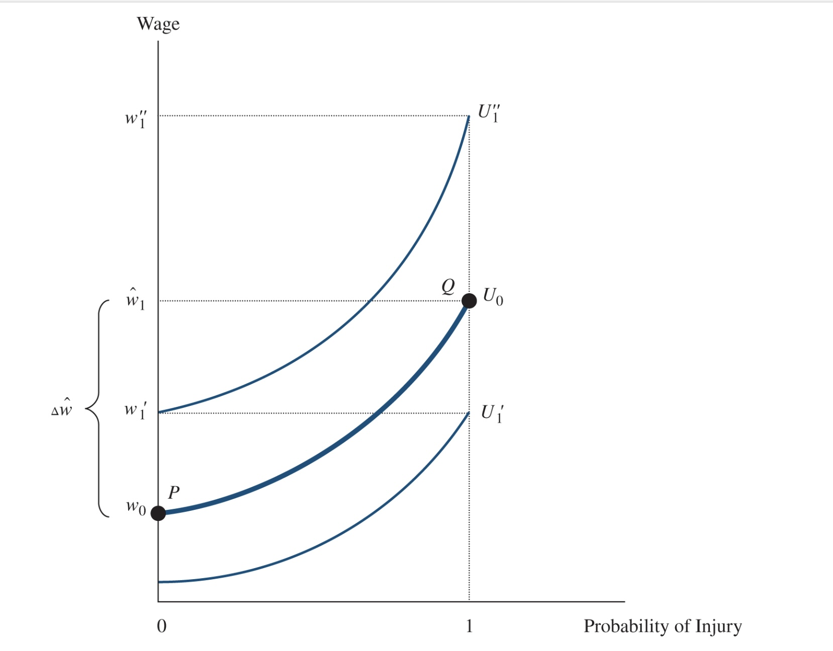
Workers care about the wage (w) they earn on the job.
Utility =F(w, ρ)
Indifference Curves between:
the Wage and the Probability of Injury
The worker earns a wage of W0 and gets U0 utils if she chooses the safe job. She would prefer the safe job if the risky job paid a wage ofW′1, but would prefer the risky job if that job paid a wage of W′′1. The worker is indifferent if the risky job pays ˆw1.The worker’sreservation price is Δˆw=ˆw1−w0.

Slide 4
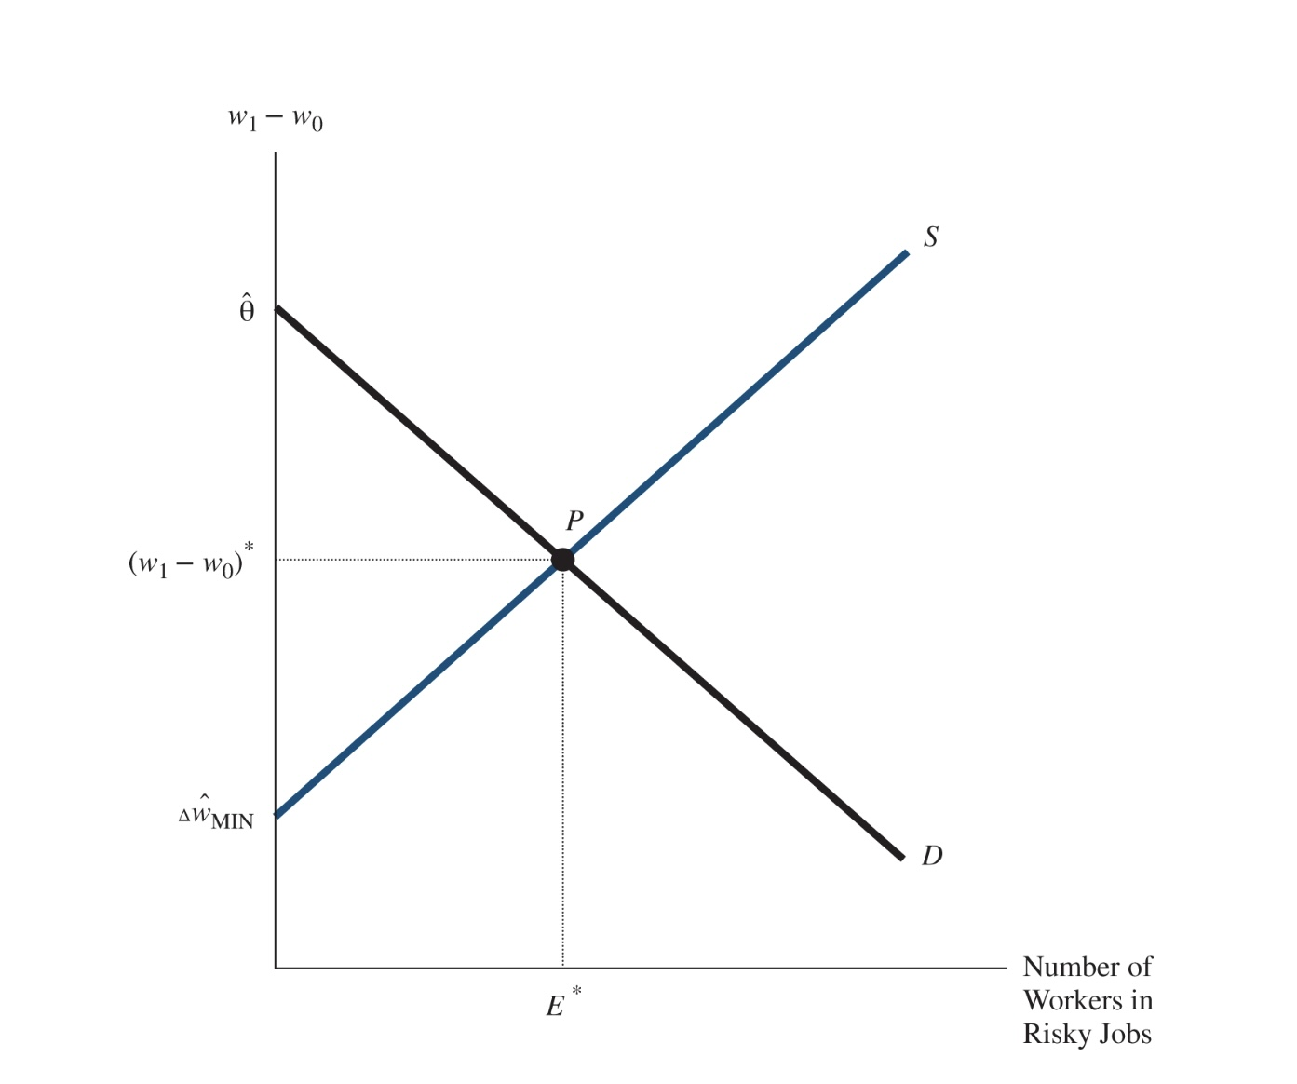
The Supply of Labor to Risky Jobs
how many workers are willing to offer their services to the risky job as a function of the wage differential between the risky job and the safe job.
Assumed that all workers dislike risk, no worker would be willing to work at the risky job when the wage differential is zero (or negative).
As the wage differential between the risky job and the safe job keeps increasing, more and more workers are bribed into the risky occupation, and the number of workers who choose to work in risky jobs keeps rising. The supply curve to the risky job, therefore, is upward sloping.

Slide 5
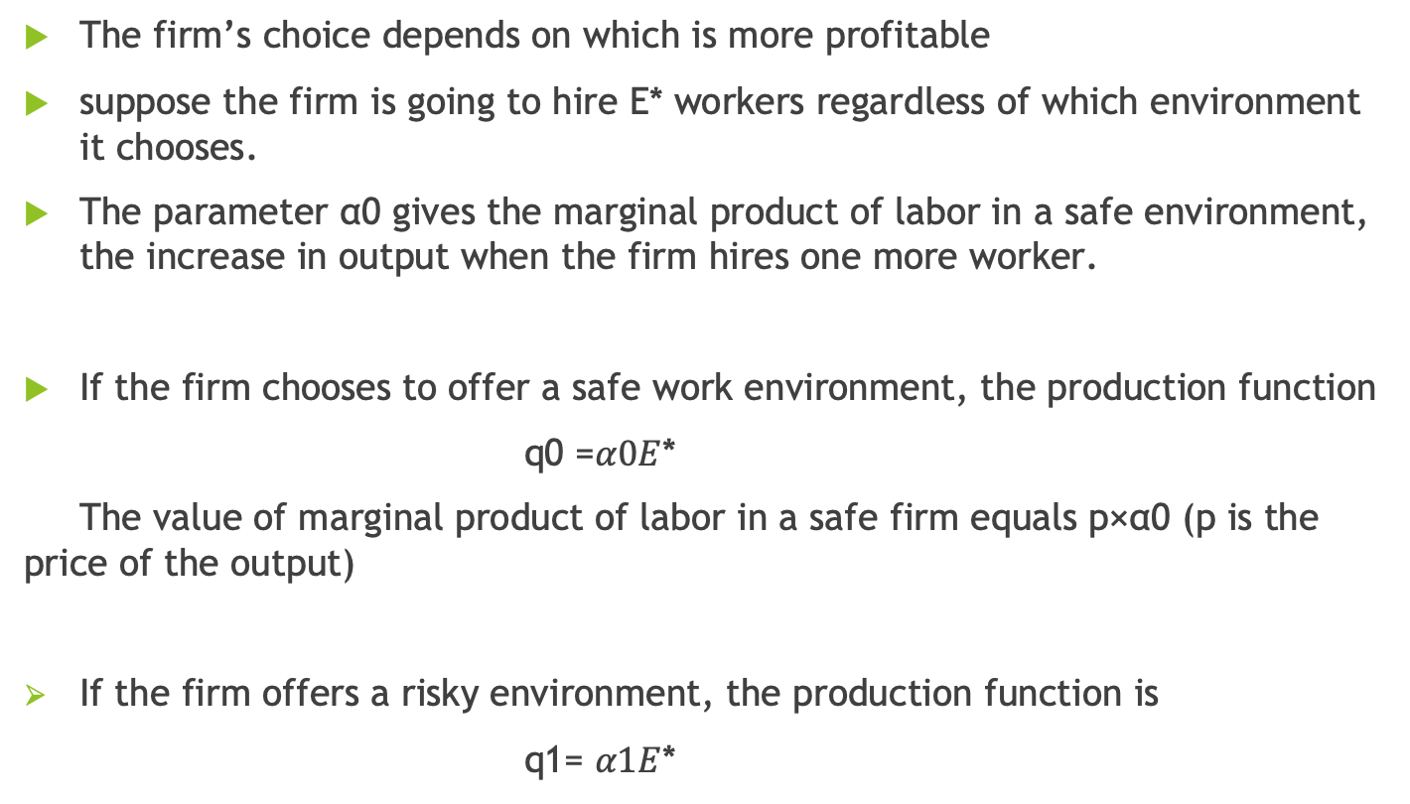
The Demand of Labor to Risky Jobs
The firm’s choice depends on which is more profitable
suppose the firm is going to hire E* workers regardless of which environment it chooses.
The parameter α0 gives the marginal product of labor in a safe environment, the increase in output when the firm hires one more worker.
If the firm chooses to offer a safe work environment, the production function
q0 =$α0E$*
The value of marginal product of labor in a safe firm equals p×α0 (p is the price of the output)
If the firm offers a risky environment, the production function is
q1= $α1E$*

Slide 6
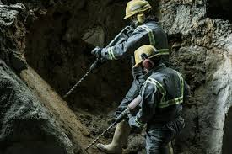


❗️Safety is not cheap
The firm’s profits equal the difference between the firm’s revenues (the price of the output p $×$the output produced) minus the firm’s costs (the wage the firm has to pay times the number of workers hired).
The profits under each of the possibilities are given by
Notes:
The marginal product (MP) of an input (like labor or capital) is the additional output produced when you add one more unit of that input, while keeping all other inputs constant.

Slide 7

Decision Making:
Define θ=pα1−pα0. As the per-worker dollar gain (i.e., the difference in the value of marginal product) when the firm switches from a safe to a risky environment.
If the additional labor cost exceeds the per-worker productivity gain the firm is better off by offering a safe environment.
If the per-worker productivity gain exceeds the additional labor cost, the firm maximizes profits by offering a risky environment

Slide 8

Reaching the Equilibrium
Notes:
If the wage differential exceeds this equilibrium level, more persons are willing to work in risky
firms than are being demanded, and the wage differential would fall. But if the wage differential fell
below the equilibrium level, too few workers are willing to work in risky jobs relative to the demand,
and the wage differential would rise.

Slide 9
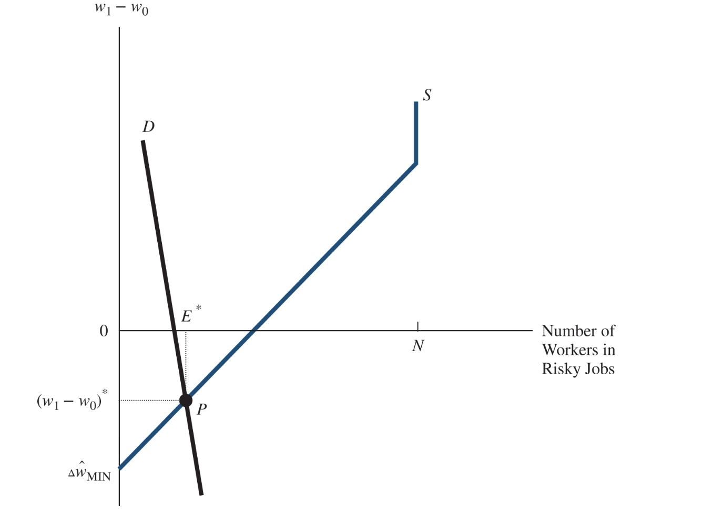
🧐 What if there is special case?
Market Equilibrium When Some Workers Prefer Risky Jobs
A worker who prefers a risky job is willing to pay for their right to work in that environment. If the demand for such workers is small, the market compensating differential may be negative.
At point P where supply equals demand, workers employed in risky jobs earn less than workers employed in safe jobs.
E.g: limited number of job openings for test pilots.

Slide 10
💡Brief Case Study: Theory at Work Jumpers in Japan
On March 11, 2011, a deadly earthquake measuring 9.0 on the Richter scale struck the east coast of Japan. Within minutes, tsunami waves more than 100 feet high struck the coast. The tsunami waves were extremely destructive, wiping out entire towns in a matter of minutes
A number of cooling systems in some of the nuclear reactors that help provide electricity to Japan began to fail, and evacuations were required around the Fukushima nuclear plant, where thousands of tons of water became radioactive. The stabilization of the situation is obviously a very dangerous task, requiring workers to be exposed to radioactive material
the Tokyo Electric Power Company (TEPCO) needed workers, called “jumpers,” who would dart into highly radioactive areas to conduct a particular task and leave as quickly as possible so as to minimize their exposure.
The going pay for a jumper was around 200,000 yen, or roughly $2,400, for less than an hour’s work.

Slide 11
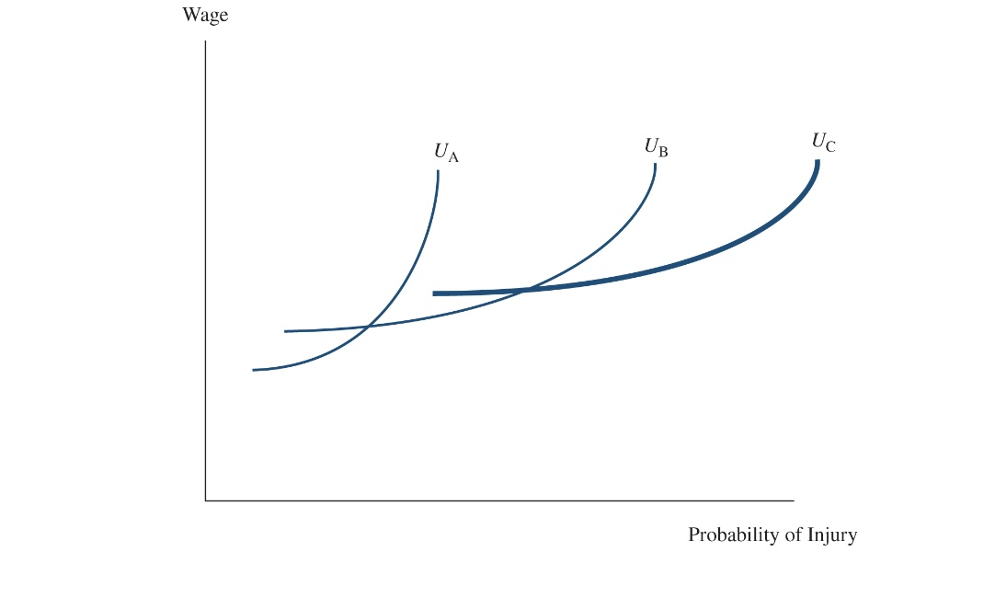
5-2 The Hedonic Wage Function
Indifference Curves for Different Types of Workers
Worker A has the steepest indifference curve, and hence the highest reservation price. A dislikes risk the most.
At the other extreme, worker C has the flattest indifference curve and the lowest reservation price.
Although worker C does not like risk, worker C does not mind it that

Slide 12
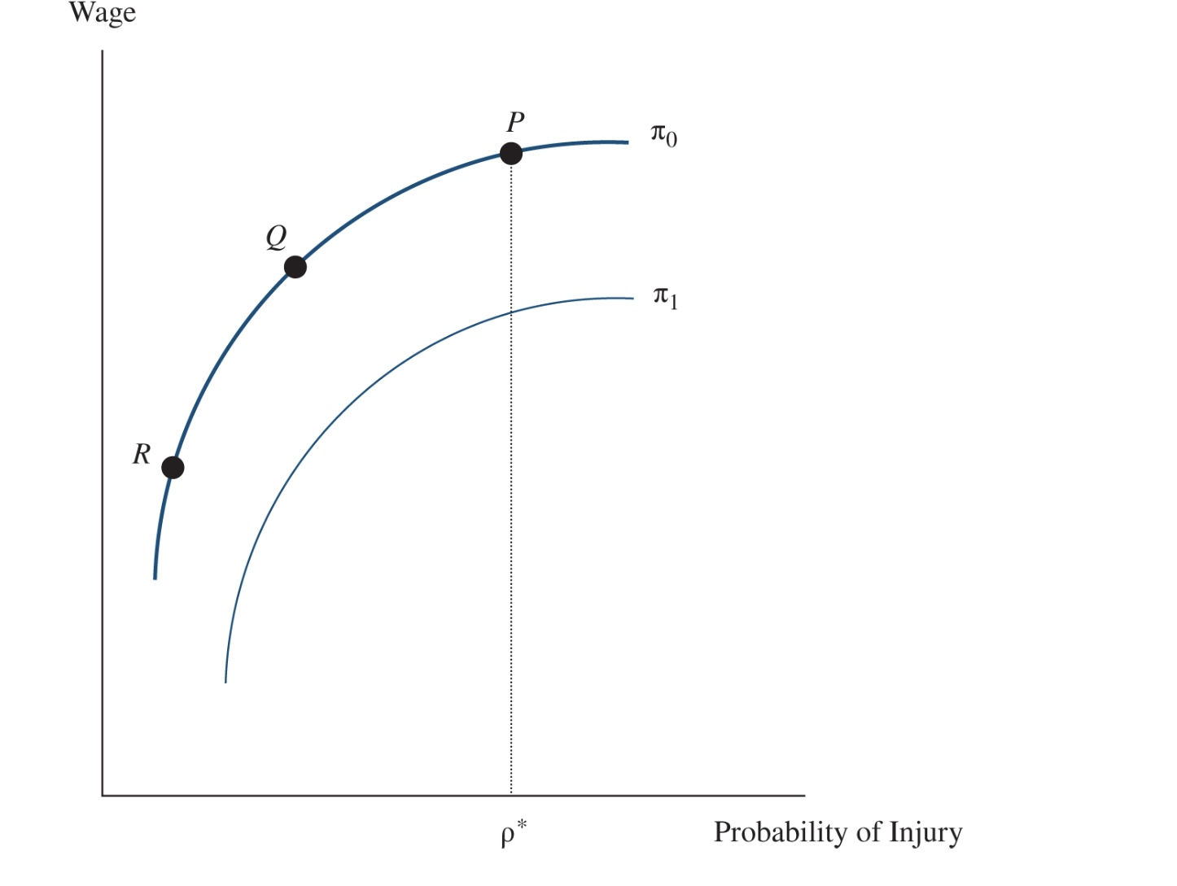
The Isoprofit Curve
Firms compete for workers by offering different job packages, where a job package consists of a particular value of the wage w and of the probability of injury ρ.
An isoprofit curve gives all the combinations between the wage and the probability of injury that yield the same profits.
It is costly to produce safety.
If profits are held constant, a firm with probability ρ* can make the workplace safer only if it reduces wages.
The isoprofit curve is upward sloping and higher isoprofit curves yield lower profits.

Slide 13
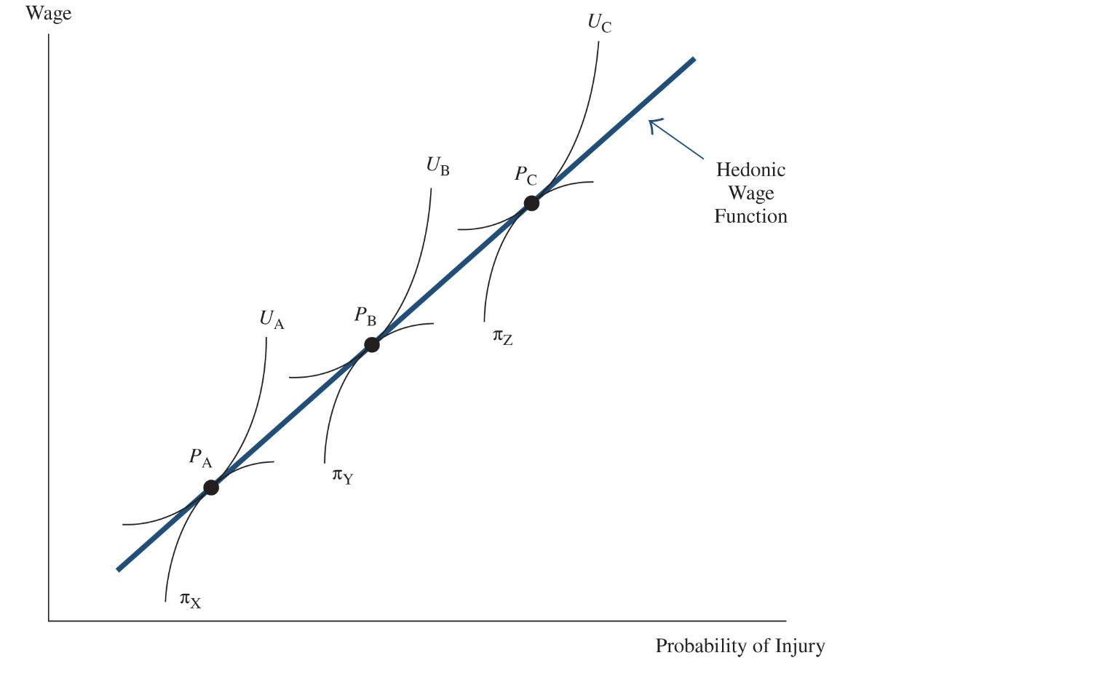
Equilibrium: Firm X (producing computer software) finds it easy to provide a very safe work environment, while firm Z (experimental fighter planes)
Workers maximize utility by choosing the job package that places them on the highest possible
indifference curve.
Worker A, who dislikes the risk of injury the most, maximizes utility at point Pa, and ends up at firm X, which happens to be the firm that finds it easiest to provide a safe work environment.
But worker C, who minds the risk of injury the least, maximizes utility at point Pc and ends up at firm Z, the firm that finds it difficult to provide a safe work environment

Slide 14
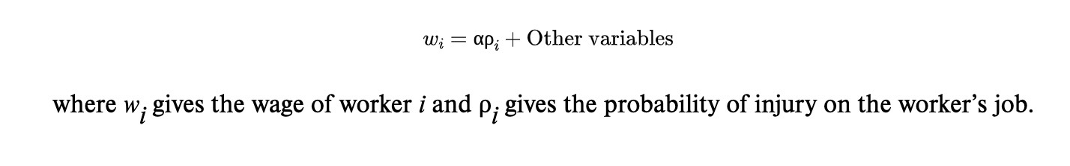
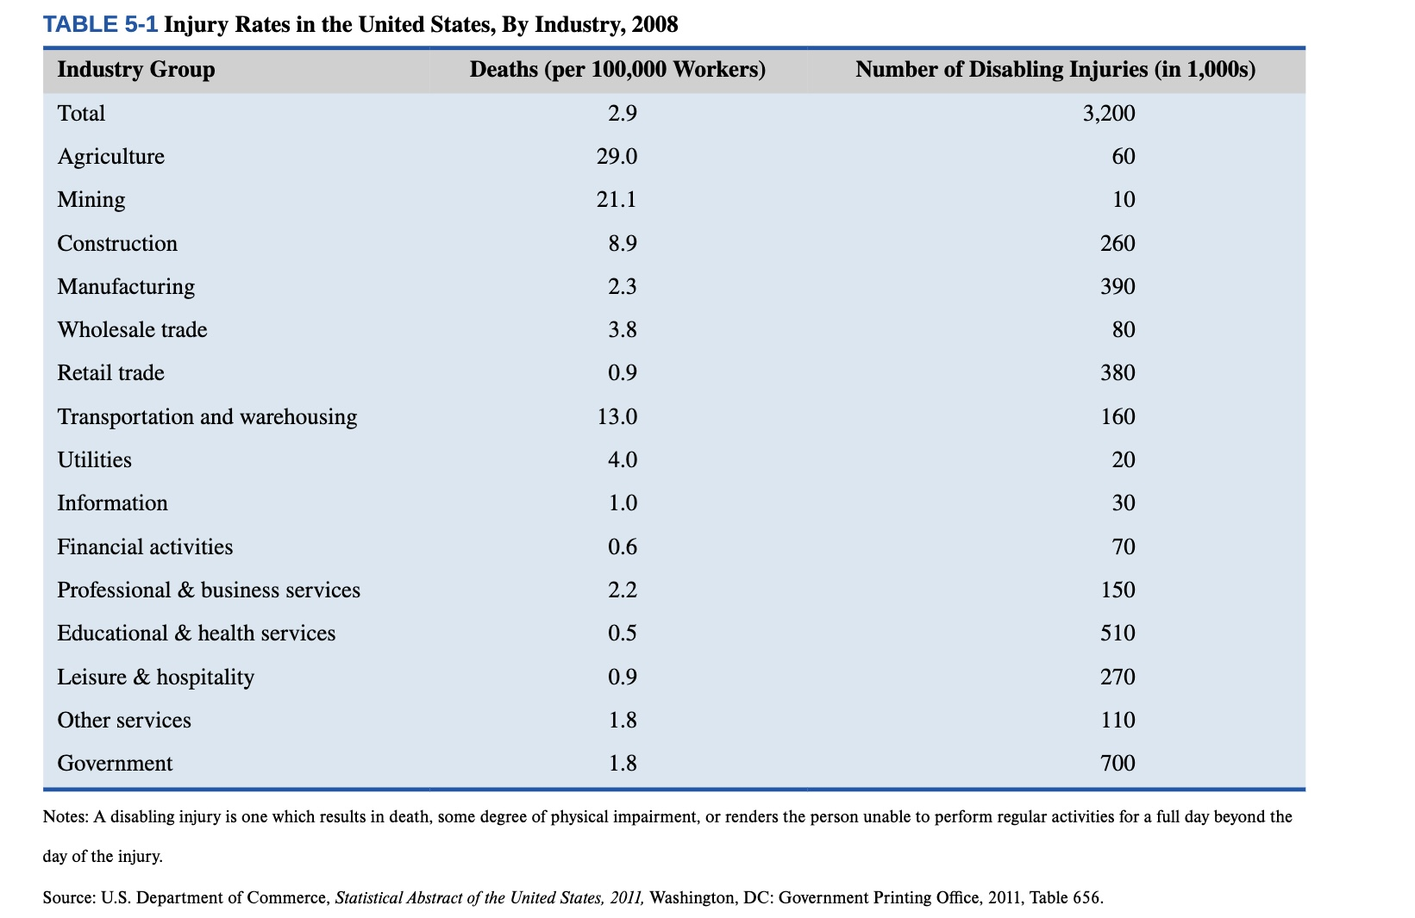
5-3: Policy Application: How Much Is a Life Worth?

Slide 15
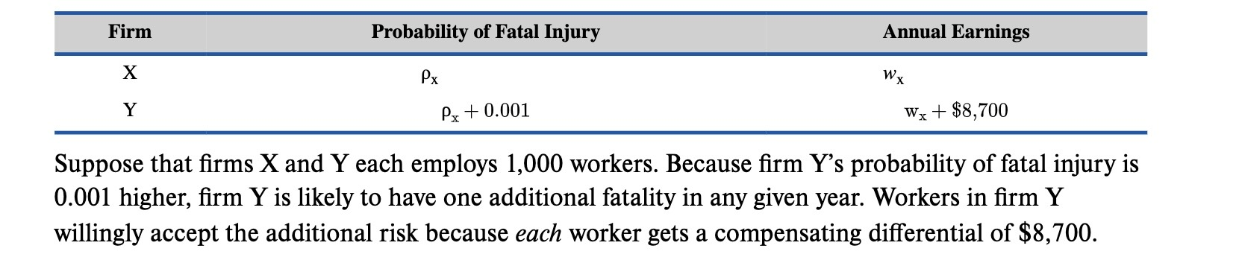
Let’s Calculate:
Workers employed in firm X have a probability of fatal injury equal to ρ
and earn w dollars per year.
Workers employed in firm Y have a probability of fatal injury exceeding that in firm X by 0.001.
The empirical evidence indicates that the riskier job, on average, pays about $8,700 more. We summarize the data as follows :

Slide 16
The wage increase resulting from a 0.001 increase in the probability of fatal injury is exactly what it takes to convince the marginal worker in firm Y to accept the slightly riskier job by holding utility constant. (In other words, it is the marginal worker’s reservation price.) This interpretation of the slope of the hedonic wage function suggests that each of the workers in firm Y is willing to give up $8,700 per year to reduce the probability of fatal injury in their job by 0.001. Put differently, the 1,000 workers employed in firm Y are willing to give up $8.7 million (or $8,700 × 1,000 workers) to save the life of that one worker who will likely die that year. therefore, value a life at $8.7 million. 🧐 Thoughts?

Slide 17
💡Brief Case Study: The Value Of Life On The Interstate
In 1987, the federal government gave states the option of raising the speed limit on their rural interstate highways, from 55 to 65 mph. By the end of 1987, 38 states had raised the maximum speed limit on their rural interstates despite the warning that such an increase would lead to more highway fatalities.
A report by the Indiana Department of Transportation makes the trade-off clear: “Speed limits represent trade-offs between risk and travel time ... reflecting an appropriate balance between the societal goals of safety and mobility.”
The states that chose to increase the speed limit were implicitly indicating that the value of time saved by driving faster was worth more than the value of the lives of the additional fatalities. ❗️(Wondering the results? )
The fatality rate (i.e., the number of fatalities per 100 million vehicle-miles of travel) rose by around 35 percent. At the same time, the amount of time required to travel a mile fell by about 4 percent.

Slide 18
❤️ Safety is always the first!!!

